Slide 1
Javascript array

Slide 2
JavaScript Array The Array is used to store multiple values in a single variable
What is an Array?
An array is a special variable, which can hold more than one value, at a time.
If you have a list of items (a list of car names, for example), storing the cars in single variables could look like this:
cars1="Saab"; cars2="Volvo"; cars3="BMW";

Slide 3
Create an Array
An array can be defined in three ways.
The following code creates an Array object called myCars:
1. var myCars=new Array();
// regular array(add an optional integer
// argument to control array's size)
myCars[0]="Saab";
myCars[1]="Volvo"; myCars[2]="BMW";

Slide 4
2. var myCars=new Array("Saab","Volvo","BMW");
// condensed array
3. var myCars=["Saab","Volvo","BMW"];
// literal array

Slide 5
Access an Array:
document.write(myCars[0]);
Modify Values in an Array
myCars[0]="Opel";

Slide 6
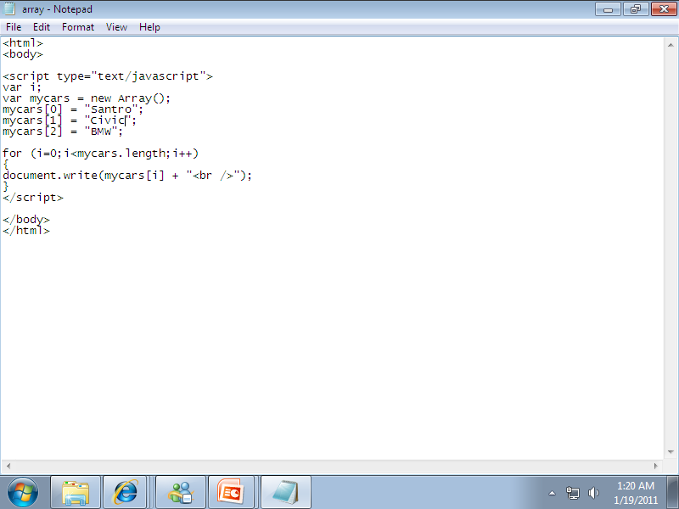
Example Of An Array

Slide 7
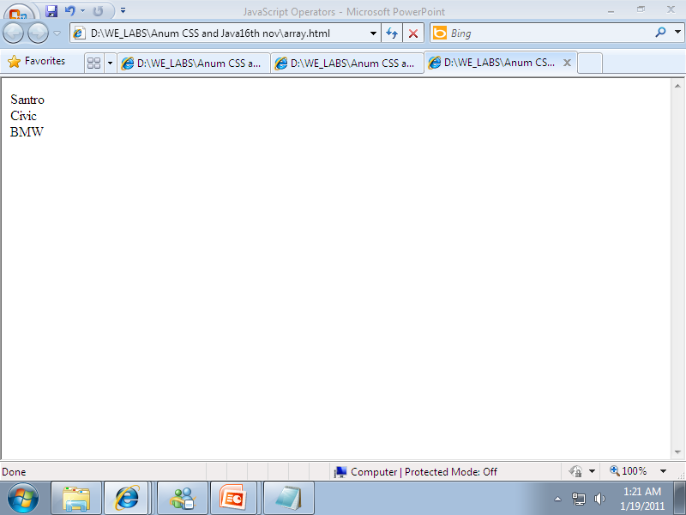
Output

Slide 8
JavaScript For...In Statement
The for...in statement loops through the elements of an array.
Syntax
for (variable in object) { code to be executed }

Slide 9
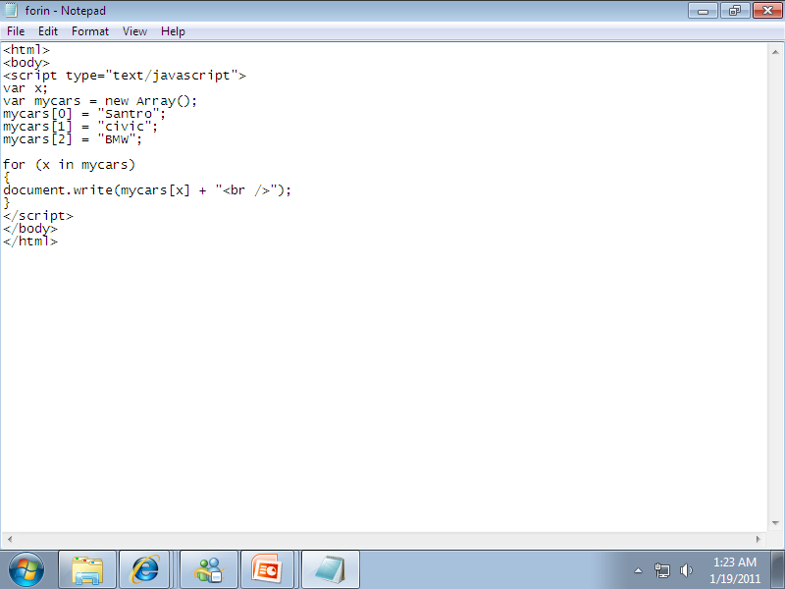
Example of For In Loop

Slide 10
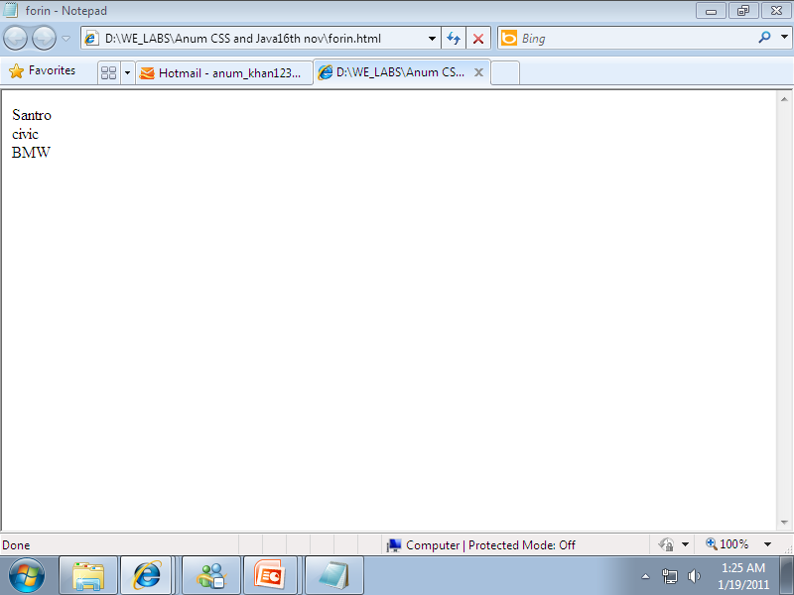
Output

